Slide 1
Capstone Project - The Battle of Neighborhoods

Slide 2
Introduction/Business Problem
Comparing the neighborhoods of the two cities i.e. New York City & Toronto and determining whether they are similar or dissimilar?

Slide 3
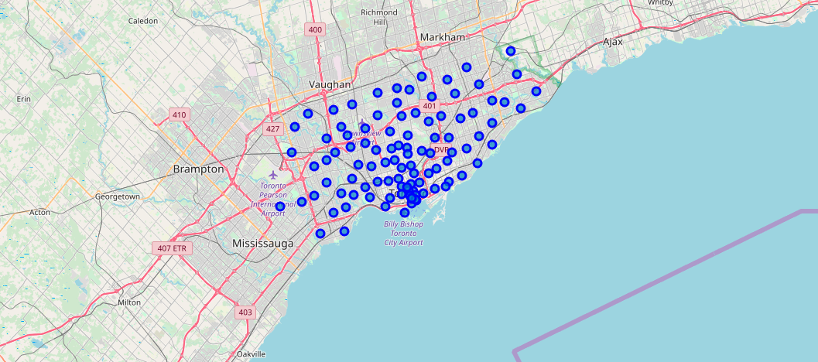
Exploring Neighborhoods: Toronto

Slide 4
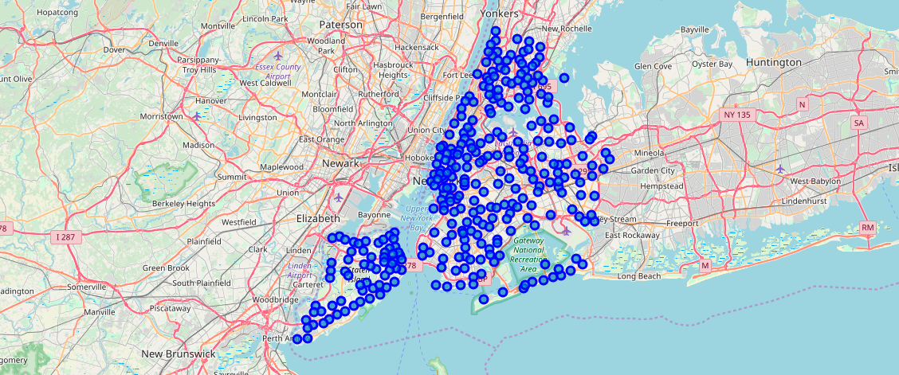
Exploring Neighborhoods: New York City

Slide 5
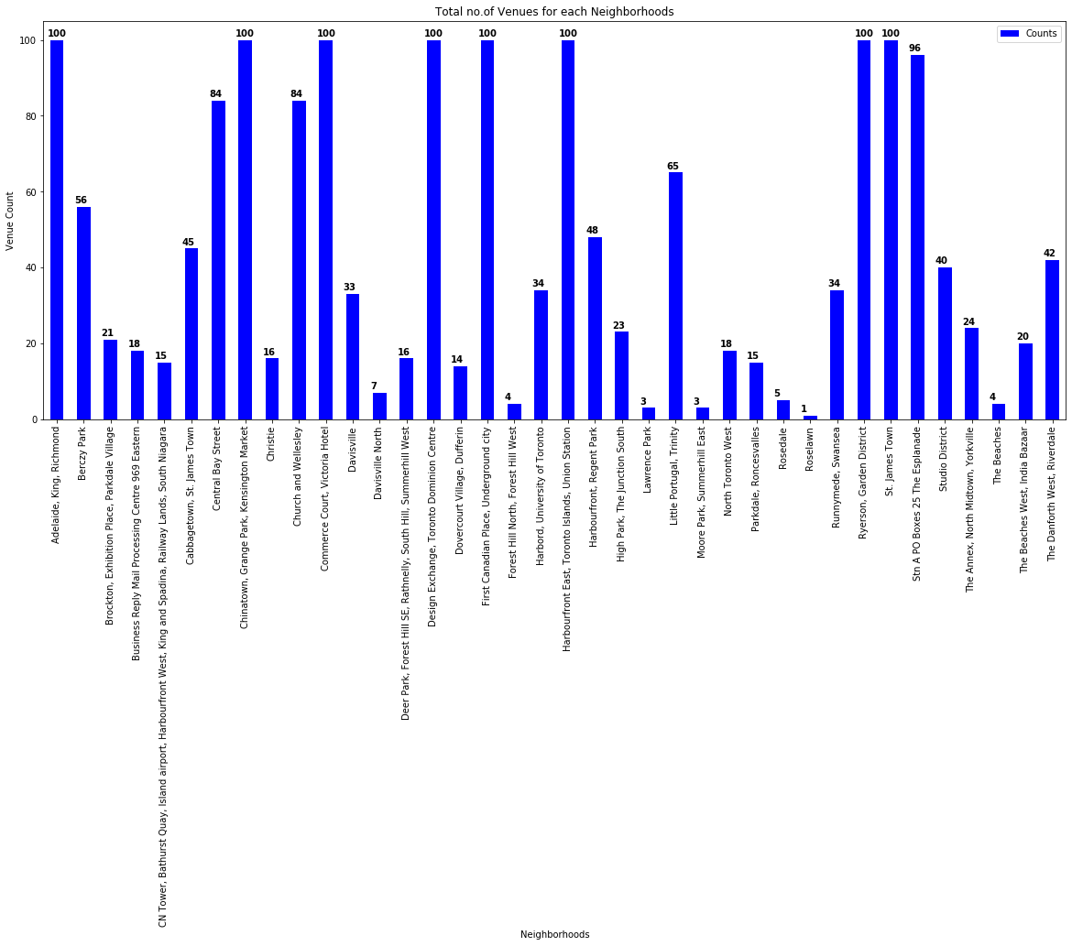
Identifying Count of Venues: Toronto

Slide 6
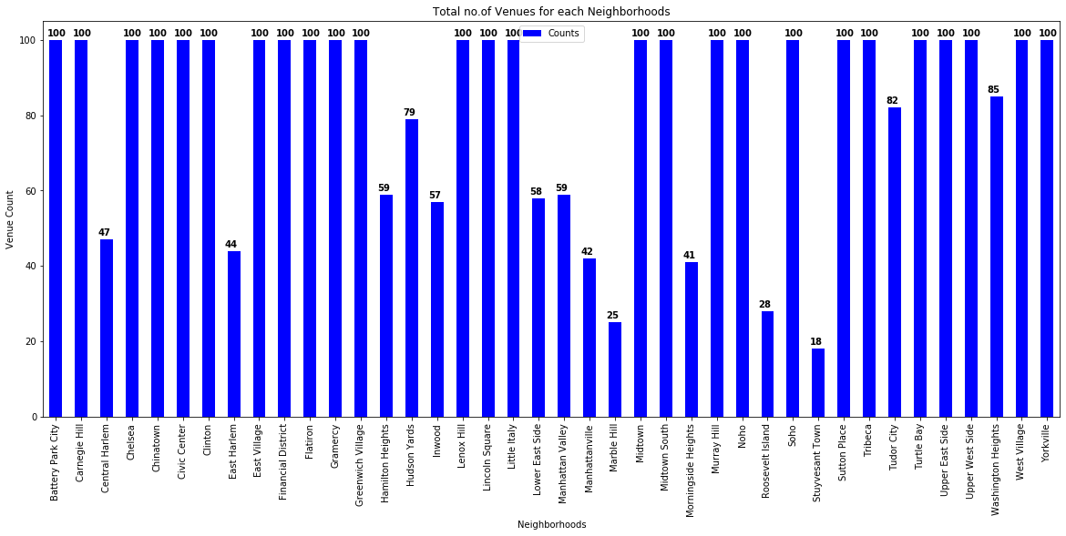
Identifying Count of Venues: New York City

Slide 7
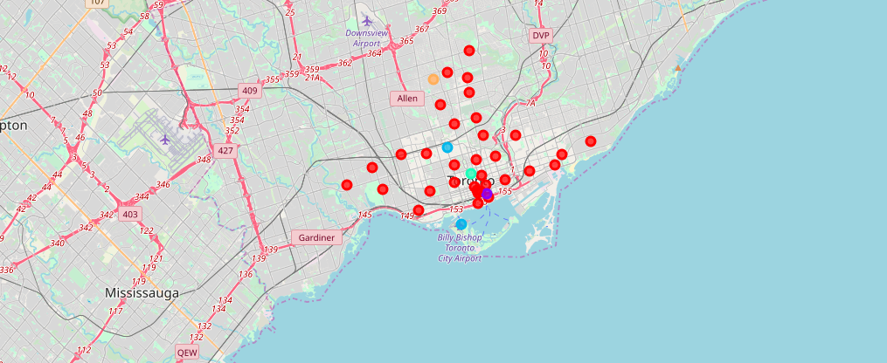
Clustering the Neighborhoods: Toronto

Slide 8
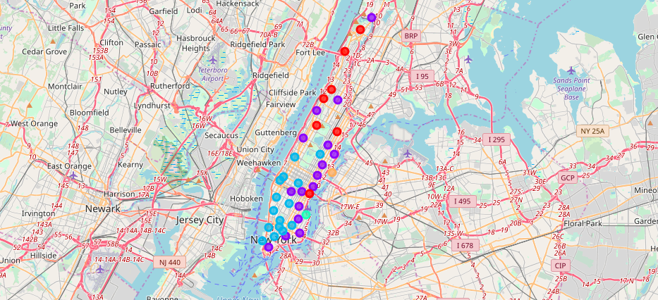
Clustering the Neighborhoods: New York City

Slide 9
Thank You!

